Slide 1
Cornerstone City Church Peninsula Plus Community Hoo Are Ya 12-02-2023

Slide 2
Holy, Holy
CCLI Song # 1540719
Nathan Fellingham
© 1995 Thankyou Music (Admin. by Integrity Music Ltd)
For use solely with the SongSelect® Terms of Use. All rights reserved. www.ccli.com
CCLI Licence No. 33265

Slide 3
1/3
Holy holy holy is the Lord God Almighty
Holy holy holy is the Lord God Almighty
Who was and is and is to come
Who was and is and is to come

Slide 4
2/3
Lift up His name with the sound of singing
Lift up His name in all the earth
Lift up your voice and give Him glory
For He is worthy to be praised

Slide 5
3/3
For He is worthy to be praised
For He is worthy to be praised

Slide 6
The Lion And The Lamb
CCLI Song # 7038281
Brenton Brown | Brian Johnson | Leeland Mooring
© 2015 Meaux Mercy (Admin. by Capitol CMG Publishing)
The Devil Is A Liar! Publishing (Admin. by Capitol CMG Publishing)
Thankyou Music (Admin. by Integrity Music)
Bethel Music Publishing (Admin. by Song Solutions)
For use solely with the SongSelect® Terms of Use. All rights reserved. www.ccli.com
CCLI Licence No. 33265

Slide 7
1/6
He's coming on the clouds Kings and kingdoms will bow down And every chain will break As broken hearts declare His praise For who can stop the Lord Almighty

Slide 8
Our God is the Lion, the Lion of Judah He's roaring with power And fighting our battles And every knee will bow before Him Our God is the Lamb, the Lamb that was slain For the sins of the world His blood breaks the chains And every knee will bow before the Lion and the Lamb Every knee will bow before Him
2/6

Slide 9
3/6
So open up the gates Make way before the King of kings The God who comes to save Is here to set the captives free For who can stop the Lord Almighty

Slide 10
Our God is the Lion, the Lion of Judah He's roaring with power And fighting our battles And every knee will bow before Him Our God is the Lamb, the Lamb that was slain For the sins of the world His blood breaks the chains And every knee will bow before the Lion and the Lamb Every knee will bow before Him
4/6

Slide 11
5/6
Who can stop the Lord Almighty Who can stop the Lord (Almighty)

Slide 12
Our God is the Lion, the Lion of Judah He's roaring with power And fighting our battles And every knee will bow before Him Our God is the Lamb, the Lamb that was slain For the sins of the world His blood breaks the chains And every knee will bow before the Lion and the Lamb Every knee will bow before Him
6/6

Slide 13
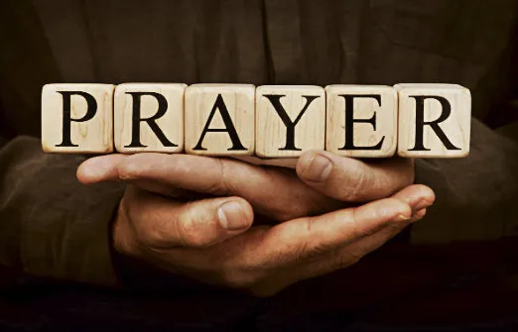

Slide 14
The Stand
CCLI Song # 4705248
Joel Houston
© 2005 Hillsong Music Publishing Australia (Admin. by Hillsong Music Publishing UK)
For use solely with the SongSelect® Terms of Use. All rights reserved. www.ccli.com
CCLI Licence No. 33265

Slide 15
1/5
You stood before creation
Eternity in Your hand
You spoke the earth into motion
My soul now to stand

Slide 16
2/5
You stood before my failure
And carried the cross for my shame
My sin weighed upon Your shoulders
My soul now to stand

Slide 17
3/5
So what can I say
And what can I do
But offer this heart O God
Completely to You

Slide 18
4/5
So I'll walk upon salvation
Your Spirit alive in me
My life to declare Your promise
My soul now to stand

Slide 19
5/5
So I'll stand
With arms high and heart abandoned
In awe of the One who gave it all
I'll stand
My soul Lord to You surrendered
All I am is Yours

Slide 21
King Of Kings Majesty
CCLI Song # 1581778
Jarrod Cooper
© 1996 Sovereign Lifestyle Music
For use solely with the SongSelect® Terms of Use. All rights reserved. www.ccli.com
CCLI Licence No. 33265

Slide 22
1/3
King of kings majesty
God of heaven living in me
Gentle Saviour closest friend
Strong deliv'rer beginning and end
All within me falls at Your throne

Slide 23
2/3
Your majesty I can but bow
I lay my all before You now
In royal robes I don't deserve
I live to serve Your majesty

Slide 24
3/3
Earth and heav'n worship You
Love eternal faithful and true
Who bought the nations ransomed souls
Brought this sinner near to Your throne
All within me cries out in praise

Slide 25
Because He Lives
CCLI Song # 16880
Gloria Gaither | William J. Gaither
© 1971 Hanna Street Music (Admin. by Gaither Copyright Management)
For use solely with the SongSelect® Terms of Use. All rights reserved. www.ccli.com
CCLI Licence No. 33265

Slide 26
1/5
Because He lives I can face tomorrow
Because He lives all fear is gone
Because I know He holds the future
And life is worth the living
Just because He lives

Slide 27
2/5
God sent His Son they called Him Jesus
He came to love heal and forgive
He bled and died to buy my pardon
An empty grave is there to prove
My Savior lives

Slide 28
3/5
Because He lives I can face tomorrow
Because He lives all fear is gone
Because I know He holds the future
And life is worth the living
Just because He lives

Slide 29
4/5
How sweet to hold our new born baby
And feel the pride and joy he gives
But greater still the calm assurance
This child can face uncertain days
Because Christ lives

Slide 30
5/5
And then one day I'll cross that river
I'll fight life's final war with pain
And then as death gives way to vict'ry
I'll see the lights of glory
And I'll know He reigns

Slide 32


Slide 33


Slide 34
Want to grow in the prophetic gift? Hear about what might be saying to his church? A great mix of prophets, teachers and apostles speaking at this RM event. Idayat (Bisi) is coordinating to take a group up there or can meet you up there in Cambridge. Book in or get in touch with Idayat for more info. 07863 226079

Slide 35
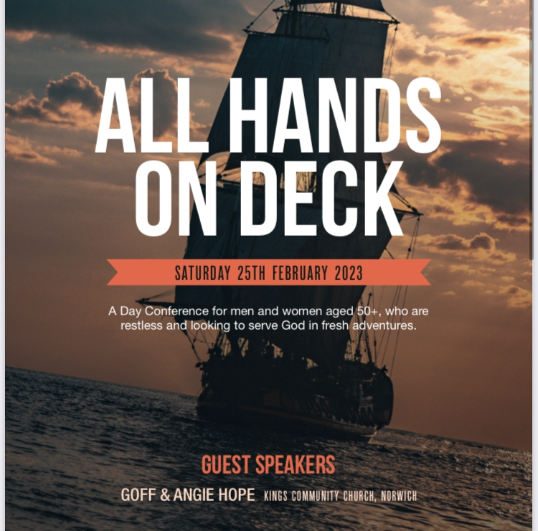

Slide 36
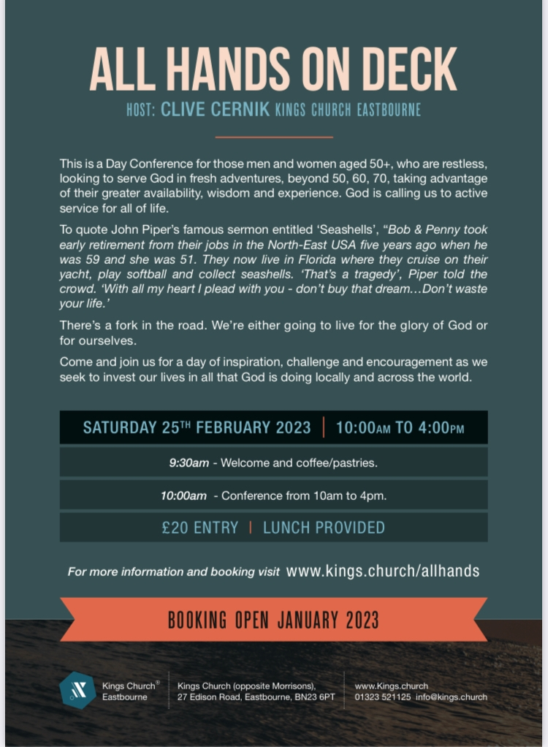

Slide 37
